Slide 1



Slide 2



Smart View for FRS reports
Denise Langston
NCFS Business Systems Analyst III
North Carolina Financial System
NC Office of the State Controller - OSC

Slide 3
Smart View for FRS reports

Slide 4
Course Objectives
What is Smart View
How to Install Smart View add-in
How to establish a connection
Show how to :
  Open a report from NCFS
  Change name description
  Suppress Zeros
  Drill in accounts

Slide 5
What is Smart View

Slide 6
What is Smart View
Oracle Smart View is an add-on to Microsoft Word, PowerPoint, and Excel.
Using Smart View, you can view, manipulate, and share data in Excel, Word, and PowerPoint interfaces. Smart View is a comprehensive tool for accessing and integrating Enterprise Performance Management, Business Intelligence, and General Ledger content from Microsoft Office products.
Smart View provides the ability to create and refresh spreadsheets to use real-time account balances and activity.

Slide 7
How to install Smart View

Slide 8
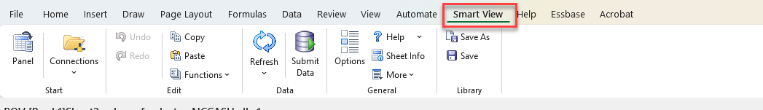
How to install Smart View
Close Microsoft products, specifically Excel, Word, PowerPoint, and Outlook
Note: Teams and Edge can stay open
Follow Steps in QRG
Navigate to OSC Sharepoint site and download files
Double click SmartView.exe file
  File will automatically start download
  Select Run and follow prompts
Once complete open Excel to ensure you have the Smart View Ribbon

Slide 9
How to establish a connection

Slide 10
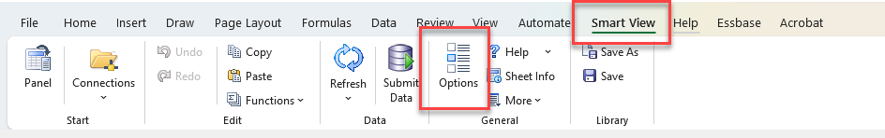
How to establish a connection
Now that you have the Smart View add-in downloaded, we need to establish a connection to the ERP system to see data.

Slide 11
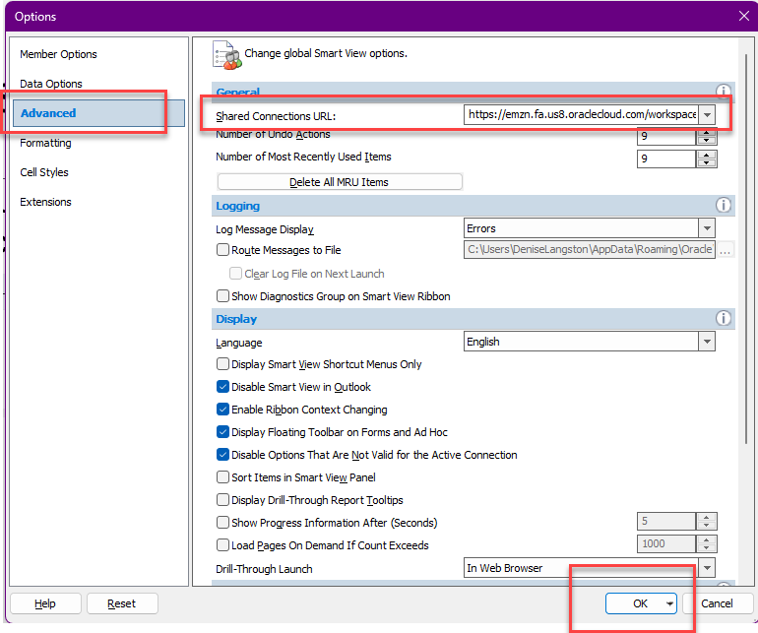
How to establish a connection, cont.
https://emzn.fa.us8.oraclecloud.com/workspace/SmartViewProviders

Slide 12
Example

Slide 13
Getting to know the Smart View Toolbar

Slide 14
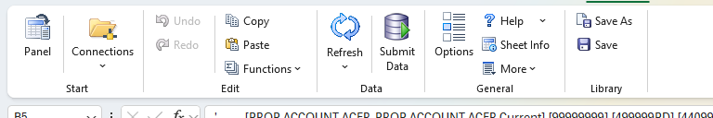
Getting to know the Smart View Toolbar

Slide 15
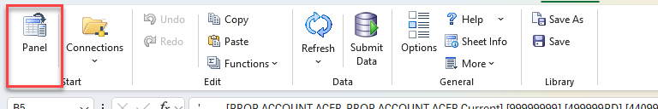
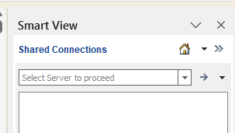
Getting to know the Smart View Toolbar, cont.
Panel – Opens Smart View panel on the left of the screen.
The Smart View panel is used to set a connection to
established worksheets.

Slide 16
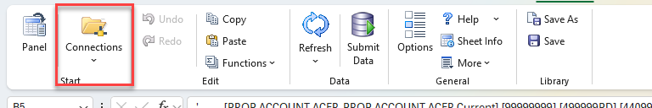
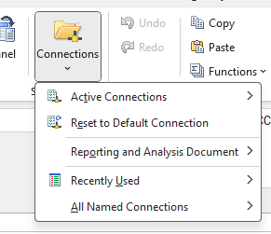
Getting to know the Smart View Toolbar, cont.
Connections – Dropdown includes all connections that have previously been made.
Note: Recently used is helpful to find recent connections if the worksheet losses connection.

Slide 17
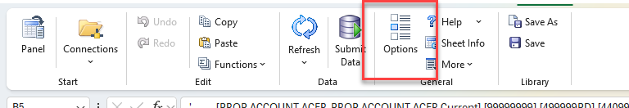
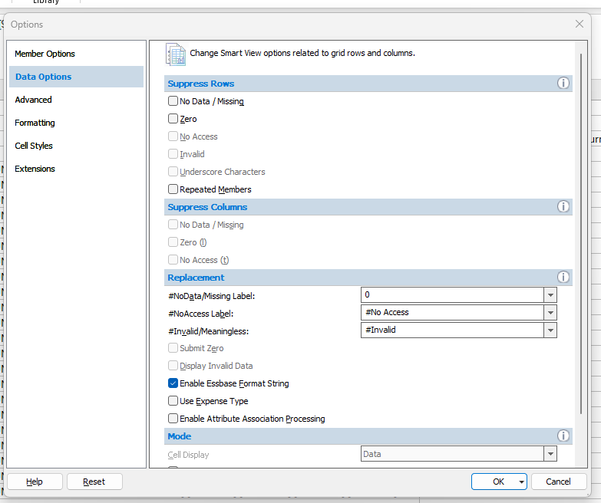
Getting to know the Smart View Toolbar, cont.
Options – Open another window with options on how to view
data. We previously discussed this is where you add the
URL for the Shared Connection to NCFS.
You can use this to Suppress Zeros

Slide 18
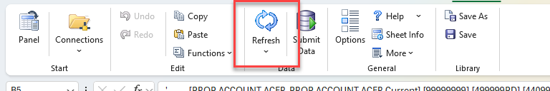
Getting to know the Smart View Toolbar, cont.
Refresh – Refreshes the data to the database. This is extremely useful when making changes to dimension members or changing how you view the data.
When in doubt refresh!

Slide 19
Getting to know the Essbase Toolbar

Slide 20
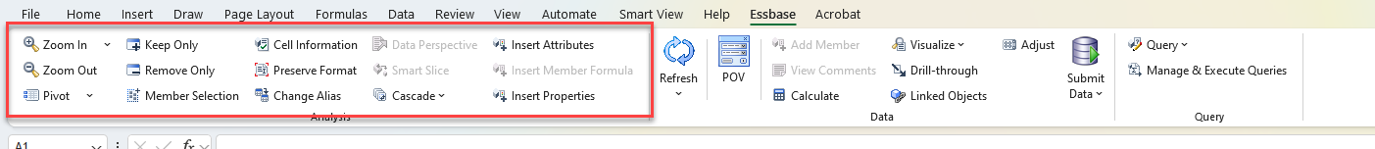
Getting to know the Essbase Toolbar
These buttons help you maneuver the data how you would like to see it. For example:
  Zoom In and Zoom Out allow you to drill in and out of the data.
  Pivot – allows you to pivot dimensions from columns to rows or rows to columns
  Keep Only and Remove Only allow you to narrow your data reports.
  Member Selection allows you to search for and add new members to customize the view

Slide 21
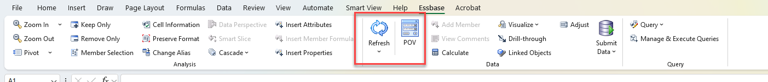
Getting to know the Essbase Toolbar, cont.
Refresh – Allows you to refresh the data feed after any changes have been made.
POV – Allows you to select dimensions to narrow your report view.

Slide 22


